Slide 1
The writing process

Slide 2
Why learn to write?
Almost all human beings grow up speaking their first language (sometimes also the 2nd and 3rd )
Spoken language (child) acquired naturally, being exposed to it
The ability to write has to be consciously learned
Educational context- relies on the student’s writing proficiency in order to measure his/her knowledge

Slide 3
The writing process
The blank sheet of paper & the writer’s cramp
The features of the writing process
Purpose
Topic
Context
Audience
Stages of the writing process

Slide 4
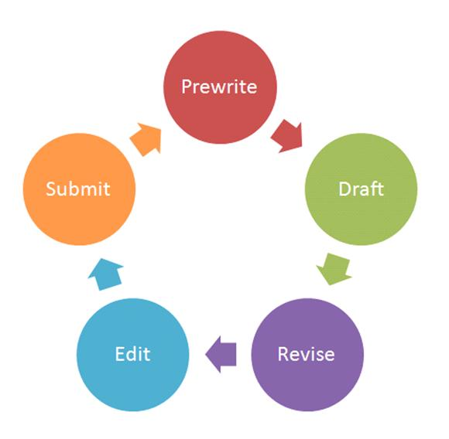
Stages of the writing process
Process – the stages a writer goes through in order to produce something in its final written form
The stages:
Prewriting
Planning
Defining the task/problem
Collecting ideas, sorting out ideas
Drafting
Revising
Proofreading and editing
Submitting/ publishing

Slide 5
Stages of the writing process
Planning
Define the topic
What is the topic of the paper/article/proposal?
Imposed (by teacher/employer)?
Define the purpose
Why am I writing it?
Influences the language used/ information provided
Define the audience
Influences shape/language/information
Define the context
How long/ due date/ submission form

Slide 6
Stages of the writing process
Defining the problem/ task
Usually, when faced with a problem technical communicators:
Conduct an investigation
Reach some conclusions
Make recommendations (based on goals/criteria/constraints)
Present solutions/recommendations to decision-makers (who induce change or actions of problem-solving)

Slide 7
Stages of the writing process
Defining the problem/task
Different types of problems:
Well-defined (one solution, e.g. technical calculations)
Ill-defined (more time-consuming, more solutions, e.g. improve the performance of a device)
Approach:
Identify the problem
Determine how you should address it
If there are more problems
Identify the most important one
Organize problems in a hierarchy

Slide 8
Stages of the writing process
Defining the task
What are you supposed to do?
Describe it
Recommend a solution
Deal with the whole range of the problem/ only part of it
Also ask yourself:
Are you an insider/ outsider?
Are you a specialist?
Do you have the power to make/ influence decisions?

Slide 9
Stages of the writing process
Generating/collecting ideas
Various sources:
Books, journals, encyclopedias, case studies, tables, graphs, surveys, etc.
Working methods
Note taking
Making lists
Summary
Questions
Intuitive- brainstorming, free writing

Slide 10
Stages of the writing process
Generating/collecting ideas
Note taking
Lectures, conferences, meetings, instructions
Active attitude- select the essential information
Well-ordered, logical string of information flow
Very personal method of taking notes (abbreviations, symbols, numbering, underlining, personal comments, questions, etc.)

Slide 11
Stages of the writing process
Generating/collecting ideas
Note taking covers:
Distributive attention (what is heard/read)
Capacity to comprehend (analyze, make a synthesis, language command)
Making decisions in a limited time interval
Handling techniques (summarizing, paraphrasing, citation, association with previous knowledge)

Slide 12
Stages of the writing process
Generating/collecting ideas
System of codes/abbreviations
Code | Signifies
? | I don not understand
M | Keep in mind
C | Check
Def | Definition
Ex | Example
Clas | Classification
Comp | Comparison
OK | I agree with it
! | Interesting
!!! | Very important

Slide 13
Stages of the writing process
Generating/collecting ideas
Summary
Systematically and briefly write the ideas, data, information from a material
Message not altered by the reader’s opinion
Analytical method/ questions
Who? What? Where? When? How? Why?
Answer and give details
Analytical method/ focus
Define the general topic, separate it in specific aspects, divide each aspect in smaller units

Slide 14
Stages of the writing process
Generating/ collecting ideas
Synthesis method
Identifying/collecting ideas from various sources
Adapting them to generate new information
Usually done by reading
Intuitive method (Brainstorming/free writing)
Set a time limit (5-10 min)
Purpose: get out all the ideas that you can about a topic
1st stage: don’t evaluate/criticize ideas, just generate
2nd stage: review, sort, group, eliminate, make corrections

Slide 15
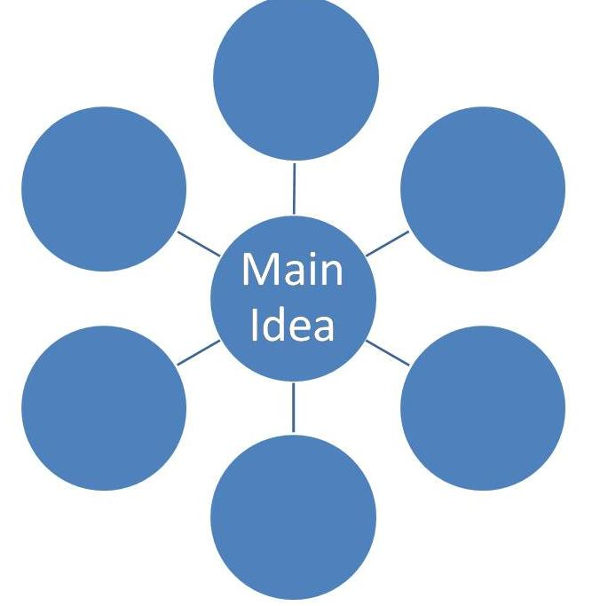
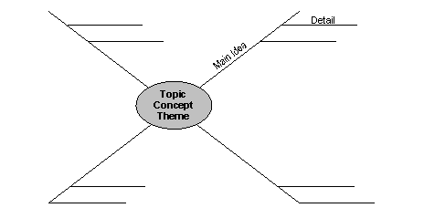
Stages of the writing proces
Generating/collecting ideas
Brainstorming

Slide 16
Stages of the writing process
Sorting out/ organizing ideas
Grouping ideas according to a logical/hierarchical order ( level of importance, type of argument, etc.)
Designing the headings of the sections, numbering sections, arranging sections in a given order, etc.

Slide 17
Stages of the writing process
Drafting
Putting words on paper
Draft- the first version of a piece of writing
Based on the information collected previously
Turn your prewriting ideas into sentences
Should be written quickly, without editing/revising
Don’t stop the flow of ideas
Start with the body draft, continue with conclusions and introduction
Be creative!

Slide 18
Stages of the writing process
Revising
Check:
Audience and purpose
Organization
Coherence
Logic and unity
Arguments
Transitions
Introduction and conclusion

Slide 19
Stages of the writing process
Revision
Mark the portions where you should return and polish the text
Insert/eliminate passages or details
Let the material stay away for some time and repeat revision
Last revision: check formats (headings, subheadings, chapters, paragraphs)

Slide 20
Steps of the writing process
Editing
Check:
Grammar
Spelling
Punctuation
Capitalization
Format
Now you have your final draft.
Submit/ publish it!

